Slide 1
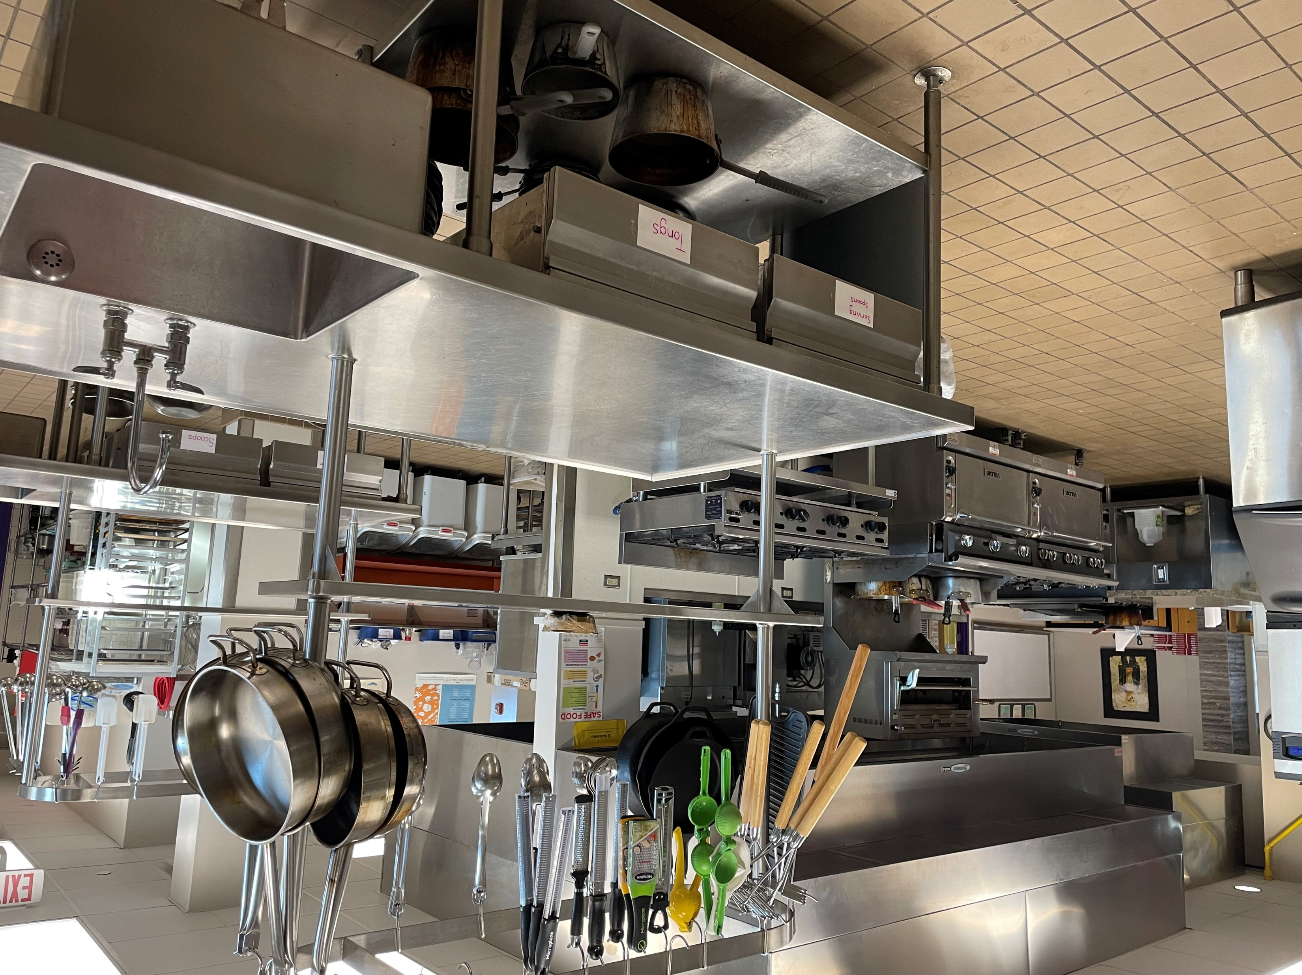
Culinary Arts
Statewide Program of Study
Hospitality and Tourism Career Cluster
The Hospitality and Tourism Career Cluster focuses on the management, marketing, and operations of restaurants and other food/beverage services, lodging, attractions, recreation events, and travel-related services. Students acquire knowledge and skills focusing on communication, time management, and customer service that meet industry standards. Students will explore the history of the hospitality and tourism industry and examine characteristics needed for success.
The Culinary Arts program of study introduces CTE learners to occupations and educational opportunities related to the planning, directing, or coordinating activities of a food and beverage organization or department. This program of study also explores opportunities involved in directing and participating in the preparation and cooking of food.
Work-Based Learning and
Expanded Learning Opportunities
Secondary Courses for High School Credit
1 Introduction to Culinary Arts
2 Culinary Arts
3 Advanced Culinary Arts
4 Practicum in Culinary Arts
OR
Food Science
Exploration Activities | Work-Based Learning Activities
Participate in Family, Career, and Community Leaders of America, SkillsUSA, or the Texas Restaurant Association | Plan a catering event or work for a catering company Participate in a cooking course Work in a restaurant
Industry-Based Certifications
Food Protection Manager Certification
Postsecondary Opportunities
Associates Degrees
Hotel and Restaurant Management
Restaurant Culinary and Catering Management
Hospitality Administration/ Management, General
Culinary Arts/ Chef Training
Bachelor’s Degrees
Hotel and Restaurant Management
Food Service Systems Administration/ Management
Hospitality Administration/ Management, General
Culinary Science and Food Service Management
Master’s, Doctoral, and Professional Degrees
Hotel and Restaurant Management
Food Service Systems Administration/ Management
Hospitality Administration/ Management, General
Business Administration Management, General
SMHS Culinary Arts Kitchen
Aligned Occupations
Occupations | Median Wage | Annual Openings | % Growth
Food and Beverage Managers | $55,619 | 1,561 | 28%
Chef and Head Cooks | $43,285 | 1,366 | 25%
Food Science Technicians | $34,382 | 236 | 11%
Successful completion of the Culinary Arts program of study will fulfill requirements of the Business and Industry endorsement. Revised – August 2022

Slide 2
Culinary Arts Course Information
COURSE NAME | SERVICE ID | PREREQUISITES | COREQUISITES
Introduction to Culinary Arts | 13022550 (1 credit) 6527 | None | None
Culinary Arts | 13022600 (2 credits) 6528 | Introduction to Culinary Arts | None
Advanced Culinary Arts | 13022650 (2 credits) 6529 | Culinary Arts | None
Practicum in Culinary Arts | 13022700 (2 credits) 6535 | Advanced Culinary Arts | None
Food Science | 13023000 (1 credit) 6536 | 3 units of Science, including Chemistry and Biology | None
FOR ADDITIONAL INFORMATION ON THE HOSPITALITY & TOURISM CAREER CLUSTER,
PLEASE CONTACT: CJ Odam, SMCISD CTE Coordinator cj.odam@smcisd.net
San Marcos CISD does not discriminate on the basis of race, color, national origin, sex, disability or age in its programs or activities and provides equal access to the Boy Scouts and other designated youth groups. The following person has been designated to handle inquiries regarding the nondiscrimination policies: Stephanie Munoz ; 631 Mill St, San Marcos, TX 78666 ; 512-393-6700 ; stephanie.munoz@smcisd.net
Further nondiscrimination information can be found at smcisd.net/cte

